Slide 1
OpenBook Wisconsin
Wisconsin Transparency Website
Association of Government Accountants
November 12, 2015
Scott B. Thornton
Wisconsin Department of Administration

Slide 2
Government Transparency
The addition of new information systems have spurred interest in having more access to government spending.
The Federal Funding Accountability and Transparency Act of 2006 resulted in the USASpending.gov website.
State Governments have followed.
All 50 states now have some form of transparency website.

Slide 3
Transparency in Wisconsin
Transparency was addressed in the 2011-13 Wisconsin State Budget.
The budget, 2011 Wisconsin Act 32, included language requiring increased transparency into state government spending through the creation of a searchable website.
The requirements are detailed in s. 16.413 Wisconsin Statutes

Slide 4
Requirements
There are two areas addressed in the statutes:
State Agency Expenditures for State Operations
State Agency Contracts and Grants

Slide 5
State Agency Contracts and Grants
A copy of the contract and grant award.
The state agency making the grant or entering into the contract.
The name and address of the person receiving the grant or entering into the contract.
The purpose of the grant or contract.
The amount of the grant or the amount the state agency must expend under the contract and the name of the state fund from which the grant is paid or moneys are expended under the contract.
s. 16.413(3)(a) Wisconsin Statutes

Slide 6
State Agency Expenditures for State Operations
All state agency expenditures for state operations exceeding $100, including salaries and fringe benefits paid to state agency employees.
Copies of each financial instrument relating to these expenditures, other than payments relating to state employee salaries.
Expenditures categorized by state agency, expenditure category, expenditure amount, and the person to whom the expenditure is made.
s. 16.413(2)(a) and (b) Wisconsin Statutes

Slide 7
Website
The information must be made accessible through a searchable Internet Web site.
s. 16.413(2) & (3) Wisconsin Statutes

Slide 8
Definitions
"Financial instrument" includes any check, draft, warrant, money order, note, certificate of deposit, letter of credit, bill of exchange, credit or credit card, transaction authorization mechanism, marketable security, and any computer representation of them.
"Grant" means a payment made to a person, other than aids to individuals and organizations and local assistance and the payment of salaries and fringe benefits for state employees.
s. 16.413(1) Wisconsin Statutes

Slide 9
Definitions (cont.)
"Searchable Internet Web site" means a Web site that allows any person to search for both of the following:
  State aggregate expenditures for state operations by state agency, expenditure category, expenditure amount, and the person to whom the expenditure is made.
  Grants made by state agencies and contracts entered into by state agencies.
s. 16.413(1) Wisconsin Statutes

Slide 10
Definitions (cont.)
"State agency" has the meaning given in s. 20.001 (1). (i.e. all state agencies - any office, department or independent agency in the executive branch of Wisconsin state government, the legislature and the courts. )
"State operations" means all purposes except aids to individuals and organizations and local assistance.
s. 16.413(1) Wisconsin Statutes

Slide 11
Approach
The state had not committed to implementing an Enterprise Resource Planning (ERP) system in 2011.
Question: What could we do with data we had?
Answer: Wisconsin could deliver some of the requirements in phases.

Slide 12
Data - Expenditures
Central Accounting System - WiSMART:
  WiSMART contained external payments and internal transfers for most agencies in the Executive Branch.
  WiSMART contained detail for the Legislature.
  WiSMART did not contain detail for UW, Courts or WEDC.

Slide 13
Data - Payroll
Payroll data for most employees would be available from the state’s central payroll system (WiSPER) except for …
  Legislature
  Courts
  UW
  WEDC

Slide 14
Data – Contracts and Grants
Grant data was not centrally managed or accessible.
Contract information was not centrally managed or accessible.
Expenditures could not be easily tied to contracts, except capital projects.

Slide 15
Phased Approach – Phase 1
Decision was made to address the operating expense requirement first. This was where we had access to the most data.
Expenditure data would include:
  Expenditures beginning with FY2008
  UW Detail
  Courts Detail
  WEDC Detail
Wisconsin would include P-Card details.
Expenditures would not be limited to >$100.

Slide 16
Expenditures - Decisions
Payroll and Fringe Benefits would not be included in the first phase.
Statute requires that we include expenditures for State Operations.
  OpenBook includes only state appropriations that have a state use of “S” signifying State Operations.
  OpenBook includes only state appropriations that are included in the Chapter 20 “Schedule”

Slide 17
Expenditures - Categories
Expenditures were categorized according to their organization in the WiSMART Accounting Manual. These were logical categorizations that were generally consistent with other states.
They are a higher level than the “Category” or “Class” groupings that agencies use for their operating budgets.
OpenBook excludes the categorizations that include Salary and Fringe codes as well and Grant and Aid coding.

Slide 18
Redactions
Name redactions are made in some cases. There must be a legal reason. Some examples are:
  Confidential Expert Witness
  Juvenile Corrections
  Students at DPI Facilities
  Undercover Agents
Transactions are not redacted, just the names.
All requests are reviewed by the DOA Legal Services Division.

Slide 19
Transparency in the News
There are a number of websites and groups that watch transparency across state governments:
  National Conference of State Legislatures
  Sunlight Foundation
  U.S. Public Interest Research Group

Slide 20
U.S. Public Interest Research Group
Issue a report annually:
  Following the Money
What did they think of Wisconsin…?

Slide 21
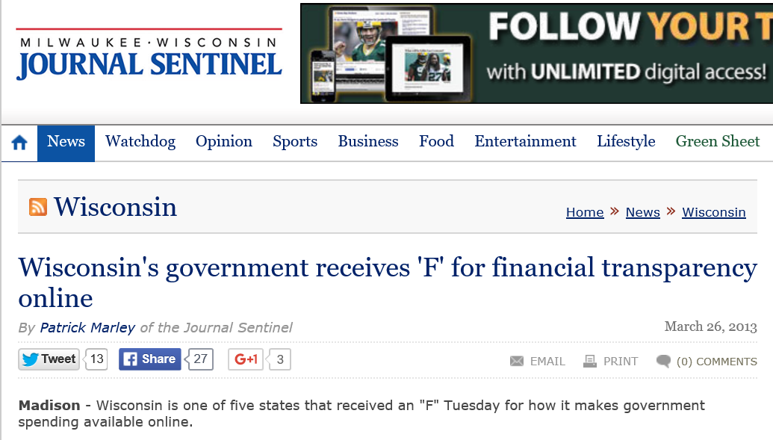
Following the Money - 2013

Slide 22
January 2014
Agencies sign off on OpenBook.
Members of the press invited for a preview of the website.
OpenBook.wi.gov goes live.

Slide 23
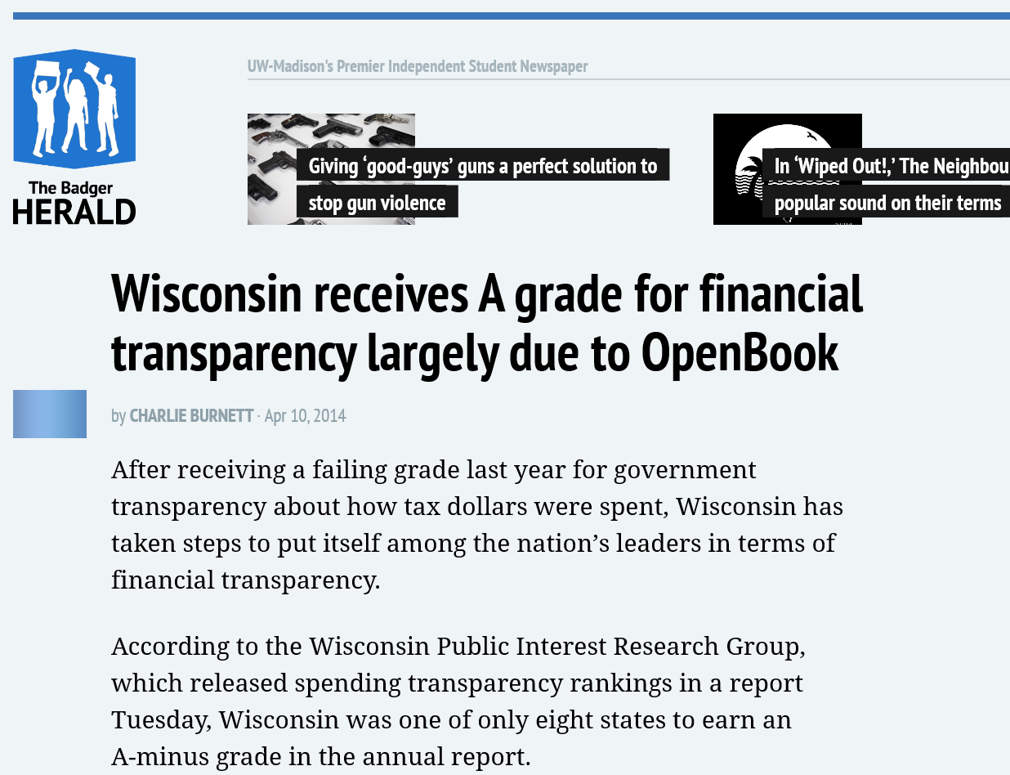
March 2014

Slide 24
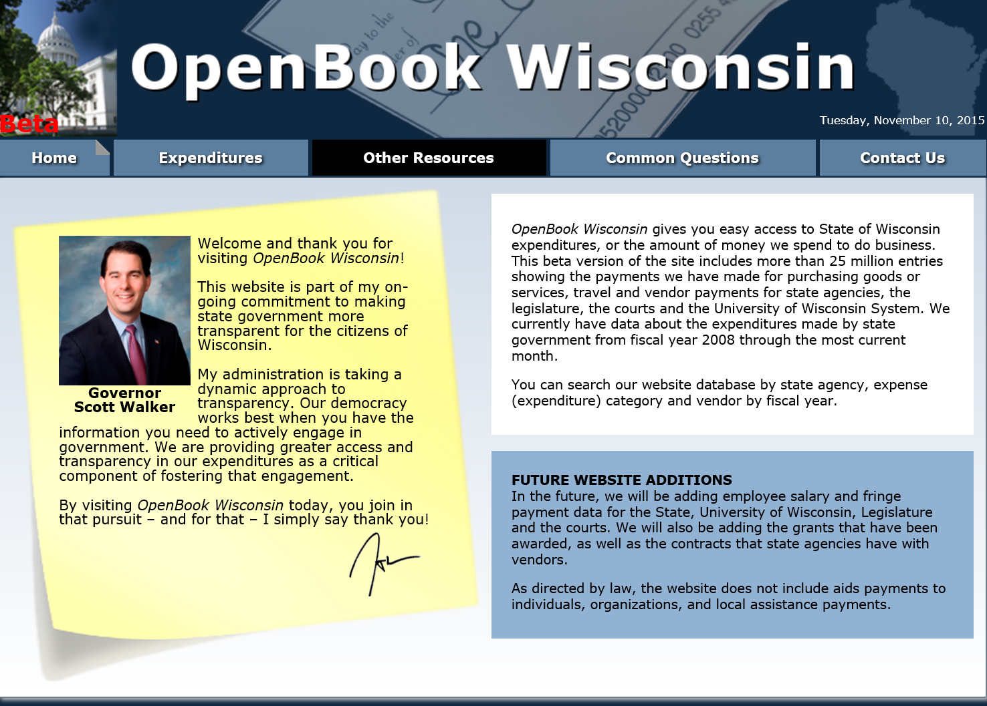
OpenBook Wisconsin

Slide 25
What is Next?
Data for the Wisconsin Courts, DOT, UW and WEDC continue to update the OpenBook database.
Expenditures for most other agencies began to be recorded in STAR, the state’s ERP system, as of October 1, 2015.
State fiscal year 2016 data is split between the legacy system, WiSMART, and STAR.

Slide 26
Challenges
How to present data from the mixed systems?
New Chart of Accounts, how to compare to prior years?
Additional interfaces to address – State of Wisconsin Investment Board (SWIB)
Updates to existing interfaces – Courts, UW, and WEDC

Slide 27
Opportunities
Contract information included in the STAR ERP system.
Grant information included in the STAR ERP system.
More payroll and fringe information available in the STAR ERP beginning in January, 2016.

Slide 28

Questions?

Slide 29
Thank You!

